Slide 1

www.worldbank.org/analyzinghealthequity
Book published by the
World Bank in 2008.
Presentations accompany
the book and are
designed as a course on
health equity analysis.
The book contents can be
downloaded from the
website above.
Notes:
Go to the website to illustrate the material that is available.

Slide 2
Analyzing Health Equity Using Household Survey Data
Lecture 1
Introduction
Notes:
1. This lecture identifies the objectives and content of the course.
2. Note that each lecture corresponds to a chapter of the book.
3. There is also a Stata do file available on the website that provides the computation undertaken in each chapter. These do files can be used as the basis of hands-on computing sessions undertaken as part of the course.

Slide 3
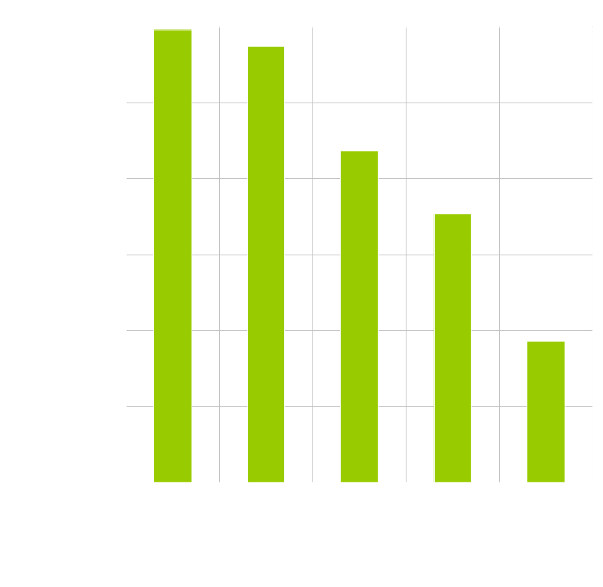
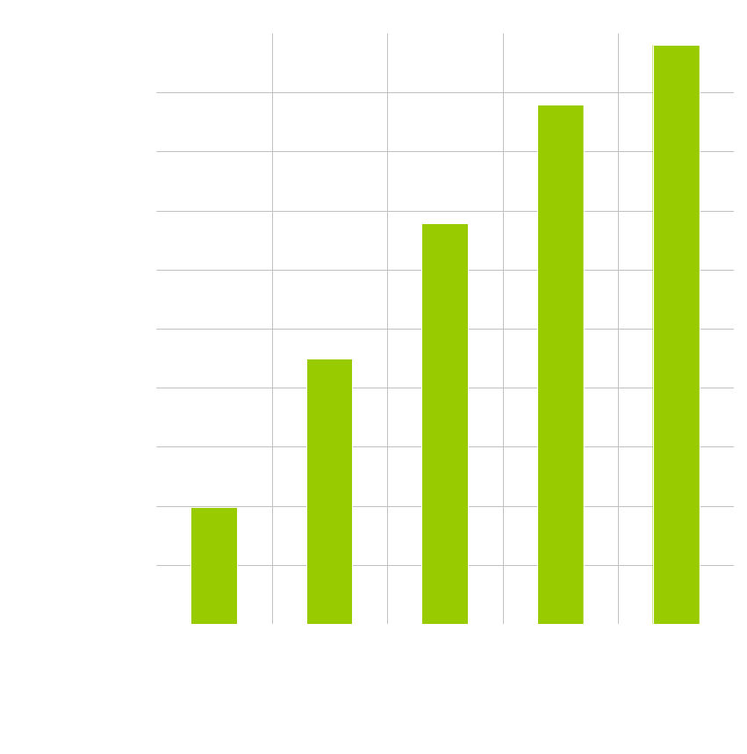
Huge rich-poor inequalities in health outcomes and health care in Bolivia
Notes:
Data are from the 2003 Bolivian Demographic and Health Survey (see lecture 2). See Davidson R. Gwatkin, Shea Rutstein, Kiersten Johnson, Eldaw Suliman, Adam Wagstaff, and Agbessi Amouzou. Socio-Economic Differences in Health, Nutrition, and Population in Bolivia (Washington, D.C.: The World Bank, 2007). http://siteresources.worldbank.org/INTPAH/Resources/400378-1178119743396/bolivia.pdf (accessed 15.01.08).
Individuals are ranked by an index of household wealth (see lecture 6).
Point to be made is that there are tremendous differences between the rich and the poor in child survival and access to maternal care. Such differences are the central interest of this course – their measurement and explanation.

Slide 4
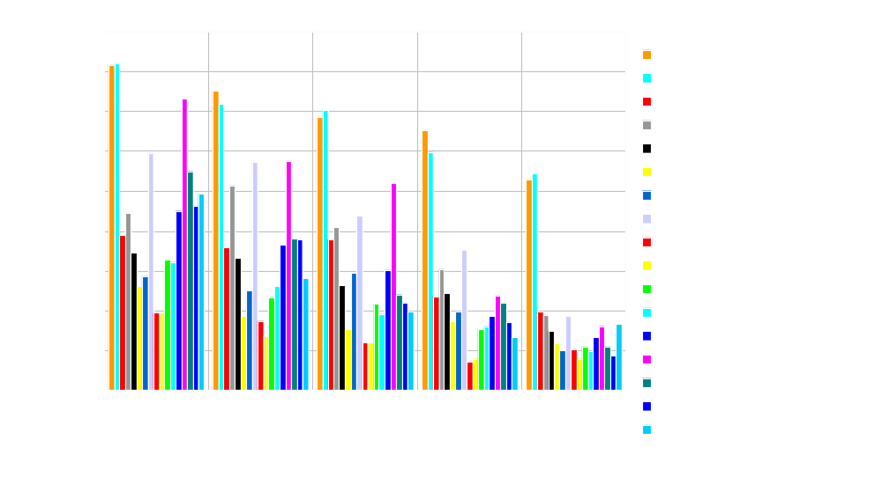
And Bolivia is not an isolated example in Latin America and the Caribbean….
Notes:
Data are from the Demographic and Health Surveys. See Davidson R. Gwatkin, Shea Rutstein, Kiersten Johnson, Eldaw Suliman, Adam Wagstaff, and Agbessi Amouzou. Socio-Economic Differences in Health, Nutrition, and Population (Washington, D.C.: The World Bank, 2007).
Point to be made is that although the levels of child mortality differ across countries, within each country there are generally very large differences between the rich and poor. It should be acknowledged that such health inequalities are often greater in LAC than in other parts of the developing world.

Slide 5
Health inequality and inequity
Rich-poor inequalities in health largely, if not entirely, derive from differences in constraints (e.g. incomes, time costs, health insurance, environment) rather than in preferences.
Hence they are often considered to represent inequities.
But in high-income countries the poor often use more health care and this may not be represent inequity.
Drawing conclusions about health equity involves consideration of the causes of health inequalities.
Notes:
Central point is that by examining differences in health, or in access to health care, we cannot immediately draw conclusions about equity. Some inequalities may be considered justified while others are not. One approach to determining health equity is to ask whether health differences are the result of individual choices from equal opportunities. If yes, they may be considered equitable. If not, then some individuals are constrained to reach a lower level of health than others and this may be considered inequitable. If the difference in constraints derives from socioeconomic status, then the health inequality may be considered to represent social injustice. See references in chapter 1 of Analyzing Health Equity (AHE).
Note that in high-income countries with universal coverage, the poor do often make greater use of the health care. But this is largely, or wholly, due to their greater need, or lower health. Hence we cannot immediately infer from this health inequality that there is inequity. This is a good example of where the analysis of health equity must take a step beyond that of health inequality (see chapter 15).

Slide 6
Equity of what?
Health outcomes, e.g. infant mortality, child growth, disability, incidence of illness, general health, life expectancy.
Health care utilisation, e.g. doctor visits, inpatient stays, vaccinations, maternity care.
Subsidies received through use of public health care.
Payments for health care (both direct and indirect).
Notes:
The course covers analysis of inequality and inequity in respect of each of these four central variables of interest.
By direct payments we mean those paid out-of-pocket. Indirect payments would include health insurance premiums but also social insurance contributions and taxes that go toward the finance of public health care.

Slide 7
Equity in relation to what?
Equity in health, health care and health payments could be examined in relation to gender, ethnicity, geographic location, education, income….
This course focuses on equity by socioeconomic status, usually measured by income, wealth or consumption.
Many of the techniques are applicable to equity in relation to other characteristics but they often require that individuals can be ranked by that characteristic.
Notes:
The early lectures on health variables are equally relevant to the examination of equity in relation to any characteristic.
Lecture 12 that considers the measurement of inequality between groups is relevant to most characteristics.
Rank based measures of inequality are introduced in lectures 7-9 and used in lectures 13-17.

Slide 8
Course objectives
To provide a step-by-step practical guide to the measurement of various aspects of health equity.
To introduce the relevant theory and literature.
To provide hands-on experience of computing health equity measures using Stata®.
To illustrate the interpretation of results through worked examples.
To stimulate analysis that will facilitate more comprehensive monitoring of health equity, especially in developing countries.
Notes:
The emphasis is very much on the practice and not the theory of health equity measurement. A basic introduction to the theory for each topic is provided but it is not a comprehensive review. The references at the end of each book chapter should be consulted for more detail.
It is envisaged that these lectures will be delivered in conjunction with practical sessions in which students can use the Stata do files on data – either provided or their own.
By providing detailed Stata code the intention is to lower the computing cost for analysts wishing to undertake health equity analysis.

Slide 9
Questions addressed by health equity analyses
Snapshots. Does inequality in child survival between the poor and better-off exist? How large is it?
Movies. Is inequality in child survival smaller now than in the 1990s?
Cross-country comparisons. Is inequality in child survival larger in Brazil than in Cuba?
Decompositions. To what extent is inequality in child survival explained by inequalities in education, health insurance cover, access to maternal and child health care, etc?
Cross-country detective exercises. To what extent is greater inequality in child survival in Brazil than Cuba explained by greater income inequality, given differences in health systems?
Program impact evaluations. To what extent is inequality in child survival reduced by an intervention such as a vaccination program, expanded health insurance cover or improved water supply?
Notes:
The terms snapshots, movies, etc come from Wagstaff and Waters (2005) (see AHE).
Point to make is that the ambition of the analysis varies in terms of the difficulty of the question addressed.
Snapshots are useful for determining where we are now, identifying problems and areas where action needs to be taken.
Movies are useful as part of a monitoring exercise. Are we moving in the right direction?
Cross-country comparisons are also useful for monitoring purposes. They help in establishing whether a country, or region, has substantially greater inequalities than others with similar characteristics and so whether the potential appears to exist to do better in reducing inequalities.
Decompositions are the first step towards identifying the causes of the inequalities and so suggesting measures that need to be taken to eliminate them.
Cross-country detective exercises are also useful in suggesting the causes of the inequalities. Their success in doing so is constrained by the large number of contributing factors that may differ across countries and which it may be difficult to control for in the analysis. But at a very general level, they may point to characteristics that are likely to responsible for inequality being greater than it need be in a country.
Program impact evaluations provide the most information. They identify how the inequality can be reduced, or what interventions are not effective in reducing it. But this requires very good data and careful statistical analysis to ensure that like is being compared with like. Identifying the impact of an intervention on inequality is even more difficult than the standard program evaluation problem of identifying the average effect of the treatment. It requires statistical methods than recognise the heterogeneity of the treatment response and can identify the this differential response by income or some other measure of socioeconomic status.
The course will cover all but the last type of analysis. Program impact evaluation is a very large topic in its own right and would require a separate course.

Slide 10
Ingredients of health equity analysis
Data usually from a household survey.
Measurement of the key variables - health/health care/health payments and of socioeconomic status.
Quantitative measures of inequality or inequity.
Multivariate methods to explain inequality, identify its causes and the impact on it of interventions
Notes:
This course is concerned with empirical health equity analysis, which, of course, requires data. This usually comes from household surveys but it could also be administrative data.
Measurement of the variable of interest must be undertaken. This is the variable that answers the “equity of what?” question posed above. There must also be a measure of socioeconomic status, the variable answering the “equity in relation to what?” question. Appropriate measurement of both types of variables requires clarity in defining the purpose of the analysis and a conceptual framework, or theory, to determine the principles that measures should accord with.
Quantitative measures of inequality/inequity summarise the bivariate relationship between the variable of interest and the measure of socioeconomic status.
Multivariate methods may be used simply to control for confounding factors when estimating the relationship between the variable of interest and socioeconomic status, to decompose the factors that contribute to this relationship or to identify the causal impact of socioeconomic status on the variable of interest.

Slide 11
Course content
The course is structured around these four ingredients, plus applications.
Part I – Data
  data requirements and sources (lecture 2)
  measurement of the key variables – child survival, anthropometrics, adult health & living standards (3-6).
Part II – Tools
  measures of socioeconomic inequality in health variables (7-9)
  multivariate analysis (10-11)
  decomposition methods (12-13).
Part III – Applications
  to health care utilisation (14-15)
  to health payments (16-19).
Notes:
Part I deals with the first two ingredients – data and measurement.
Part II deals with the 3rd and 4th ingredients – measures of inequality and multivariate methods respectively.
Part III puts the tools to work in applications.

Slide 12
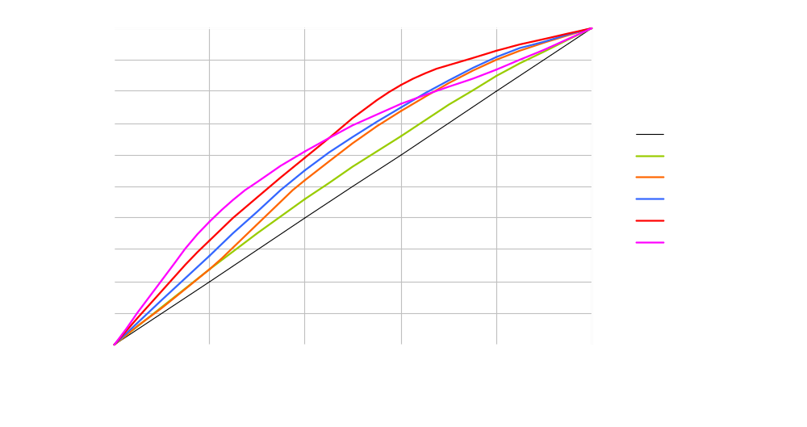
Concentration curves (lecture 7) are central to the assessment of socioeconomic inequality in health
Notes:
This and the following slides are intended to give a flavour of the type of analyses covered in the course.
The concentration curve plots the cumulative proportion of the population ranked by a measure of socioeconomic status (here an index of household wealth) against the cumulative proportion of the health measure (here under 5 deaths). The fact that all curves here lie above the diagonal indicates that child deaths are disproportionately concentrated among the poor in every country.
2. The concentration index is covered in lecture 7.
3. Dominance tests are used to establish whether the sample estimate of the concentration curve is statistically significantly different from the diagonal and to test for statistical significance between curves for different years or countries for example.

Slide 13
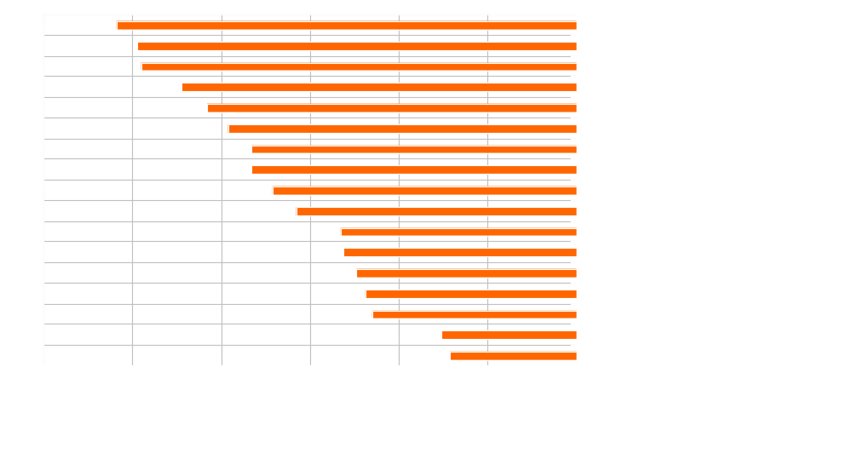
Concentration index (lecture 8) is a tie-breaker, but rests on certain value judgments
Notes:
The concentration index provides a summary measure of socioeconomic related health inequality. It is a measure of the extent to which the concentration curve diverges from the diagonal. It is zero in the case in which the curve lies on the diagonal – there is no inequality.
It provides a more convenient way of comparing the degree of inequality across many groups, countries, years, etc.
But it does require the imposition of assumptions about the weight given to inequality in different parts of the distribution.
The concentration index is introduced in lecture 8 and extensions are examined in lecture 9.

Slide 14
Multivariate methods
Estimation and inference with complex survey data (lecture 10)
Nonlinear models for health and medical expenditure data (11)
Explaining differences between groups: Oaxaca decomposition (12)
Explaining socioeconomic-related health inequality: Decomposition of the concentration index (13)
Notes:
The data used in health equity analysis are often from so-called complex sample designs with cluster sampling, stratification and non-representativeness corrected by sample weights. It is important to understand when and how these sample design features should be taken account of in the analysis.
The variables analysed are often binary (dead/alive), count (number of visits to a doctor), or censored (non-negative medical expenditures). Non-linear estimators are appropriate for the analysis of such variables.
We might want to explain why child mortality is higher for the poor than the rich. This can be done by dichotomising the socioeconomic status variable and applying well-known Oaxaca-type decomposition methods.
But dichotomisation is obviously restrictive. Using a rank measure of socioeconomic status, inequality can be measured by the concentration index and the contributing factors to this inequality can be identified by decomposing the index.

Slide 15
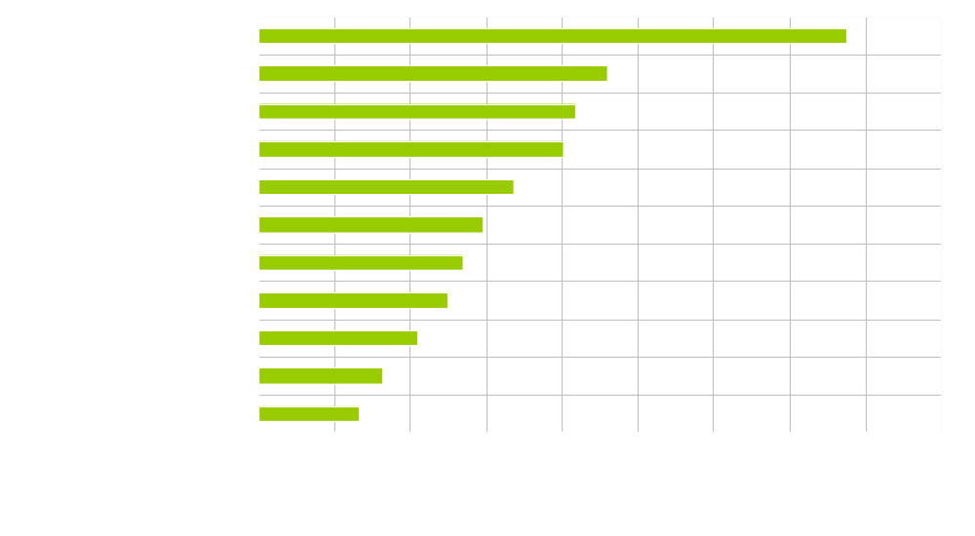
Lecture 14: Who (really) benefits from health care subsidies?
Often the better off!
Notes:
Source: O’Donnell, van Doorslaer et al (2007). The incidence of public spending on health care in Asia: Comparative evidence from Asia. World Bank Economic Review, 21(1): 93-123.
The so-called EQUITAP study.

Slide 16
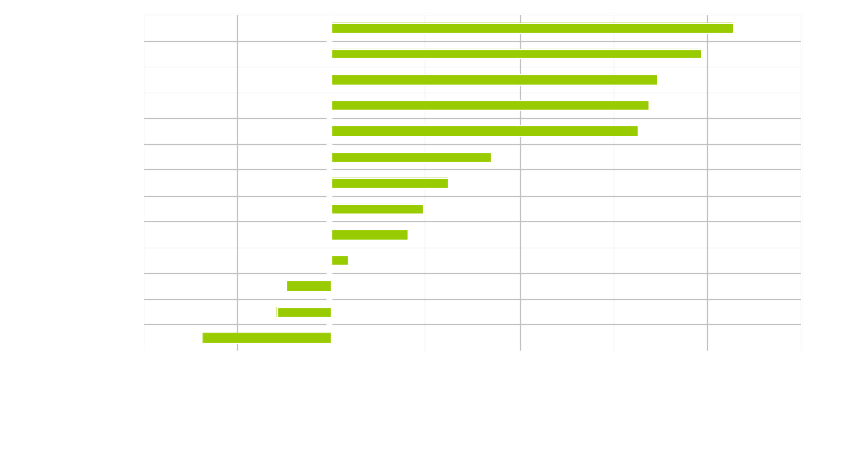
Lecture 16: Who (really) pays for health care?
Notes:
Source: O’Donnell, van Doorslaer et al (2008). Who pays for health care in Asia? Journal of Health Economics, forthcoming (EQUITAP study).
Progressive means that the better-off pay relatively more for health care as a proportion of ability-to-pay. Regressive means the reverse.
Note that, with the exception of Hong Kong, health financing is moderately regressive in the higher income countries and progressive in the lower income countries. The latter largely reflects the unequal access to health care in lower income countries – the better off pay more but that it because they also use much more health care.
The picture is quite different in high-income, particularly European, countries in which the financing of health care is largely divorced from its utilisation.

Slide 17
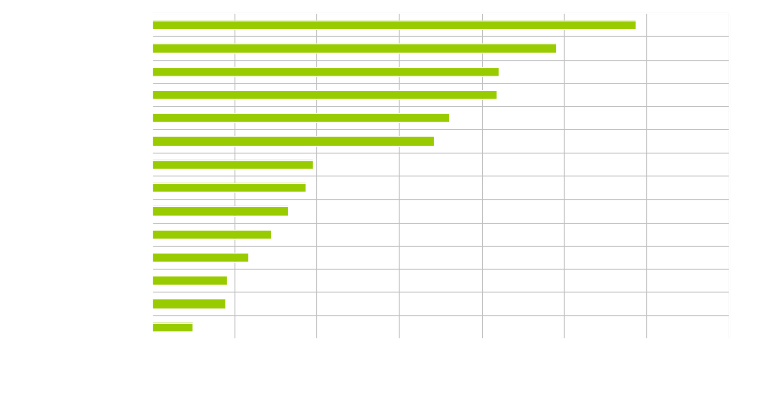
Lecture 18: Incidence of catastrophic out-of-pocket payments varies across countries
Notes:
Source: van Doorslaer, O’Donnell et al (2007). Catastrophic payments for health care in Asia. Health Economics, 16(11): 1159-85.
Catastrophic payments are defined here as OOP payments for health care exceeding 15% of household non-food consumption.
Catastrophic payments are generally greater in low-income countries that rely most on out-of-pocket financing of health care.

Slide 18
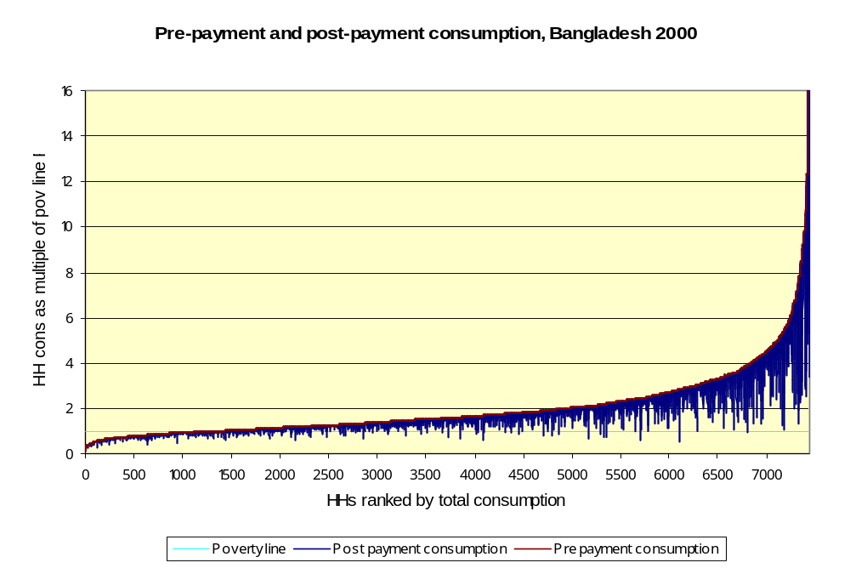
Lecture 19: Health care payments and poverty
Notes:
Source: van Doorslaer, O’Donnell et al (2006). Effect of health payments on poverty estimates in 11 countries in Asia: An analysis of household survey data. The Lancet, 368(14): 1357-64.
This is a modified Pen parade of the income distribution to show the impact of payments for health care.
The vertical axis shows household consumption as a multiple of the $1 per day poverty line (the light blue horizontal line).
Households are ranked by total consumption gross of health payments from poorest to richest, left to right.
The smooth (black) curve shows household consumption gross of health payments.
The blue “pain-drops” show by how much the consumption of each household falls after subtracting payments for health care.
One can see households being pulled below the poverty line by health payments and other households being pulled even further into poverty by health payments.

Slide 19
Acknowledgements
Participants in the ECuity and Equitap projects
The European Commission INCO-DEV programme (ICA4-CT-2001-10015) that funded the Equitap project.
The Dutch government for financial support for the production and printing of the book and these slides through Reaching the Poor II
Davidson Gwatkin and Abdo Yazbeck for encouragement and support during the production and market-testing of the technical notes, and the production of the volume
John Didier, Tanya Ringland, Chialing Yang and others at the World Bank Institute for managing the production and dissemination of the book

